Slide 1
Software Testing
Integration Testing:
-A typical software project consists of multiple software modules, coded by different programmers.
-Integration Testing is defined as a type of testing where software modules are integrated logically and tested as a group.
-Integration testing is the process of testing the interface between two software units or modules.
Integration test approaches – There are 4 types of integration testing approaches.
Top-Down Integration Testing
Bottom-Up Integration Testing
Regression Testing
Smoke Testing

Slide 2
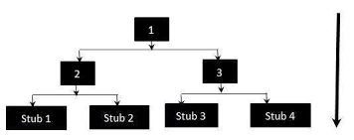
Integration Testing:
Top-Down Integration Testing :
-Is a method in which integration testing takes place from top to bottom following the control flow of software system.
-The higher level modules are tested first and then lower level modules are tested and integrated in order to check the software functionality.
-Stubs are used for testing if some modules are not ready.

Slide 3
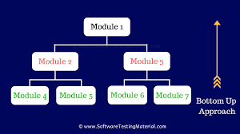
Integration Testing:
2)Bottom-Up Integration Testing
-Bottom-up Integration Testing is a strategy in which the lower level modules are tested first.
-These tested modules are then further used to facilitate the testing of higher level modules.
-The process continues until all modules at top level are tested. Once the lower level modules are tested and integrated, then the next level of modules are formed.

Slide 4
Integration Testing:
4) Smoke Testing:
- Testing process that determines whether the deployed software build is stable or not.
-Smoke testing is a confirmation for QA team to proceed with further software testing.
-It consists of a minimal set of tests run on each build to test software functionalities.
-Smoke Testing is done whenever the new functionalities of software are developed and integrated with existing build that is deployed in QA/staging environment.
-It ensures that all critical functionalities are working correctly or not.

Slide 5
Integration Testing:
3) Regression Testing
-Is the process of testing the modified parts of the code and the parts that might get affected due to the modifications to ensure that no new errors have been introduced in the software after the modifications have been made.
-

Slide 6
System Integration Testing:
- System Integration Testing is defined as a type of software testing carried out in an integrated hardware and software environment to verify the behavior of the complete system.
-It is testing conducted on a complete, integrated system to evaluate the system’s compliance with its specified requirement.
System Integration Testing (SIT) is performed to verify the interactions between the modules of a software system.
-It deals with the verification of the high and low-level software requirements specified in the Software Requirements Specification/Data and the Software Design Document.

Slide 7
Bi-directional Integration testing
-Bi-directional Integration, is a kind of integration testing process that combines top-down and bottom-up testing.
-Using stubs, it tests the user interface in isolation as well as tests the very lowest level functions using drivers.
Scenario Testing
-Scenario Testing in software testing is a method in which -actual scenarios are used for testing the software application instead of test cases.
The purpose of scenario testing is to test end to end scenarios for a specific complex problem of the software. ---Scenarios help in an easier way to test and evaluate end to end complicated problems.
As a tester, you should put yourself in the end user’s shoes and figure out the real-world scenarios and use cases of the Application Under Test.

Slide 8
Use Case Testing:
-Use Case Testing is a software testing technique that helps to identify test cases that cover entire system on a transaction by transaction basis from start to end.
Test cases are the interactions between users and software application.
Use case testing helps to identify gaps in software application that might not be found by testing individual software components.
Use cases are made on the basis of user actions and the response of the software application to those user actions.

Slide 9
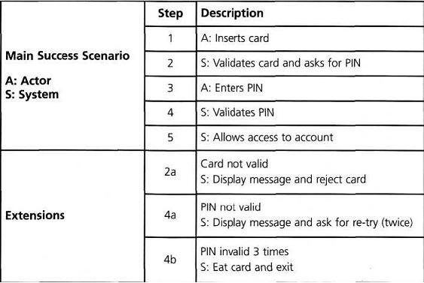
Use case

Slide 10
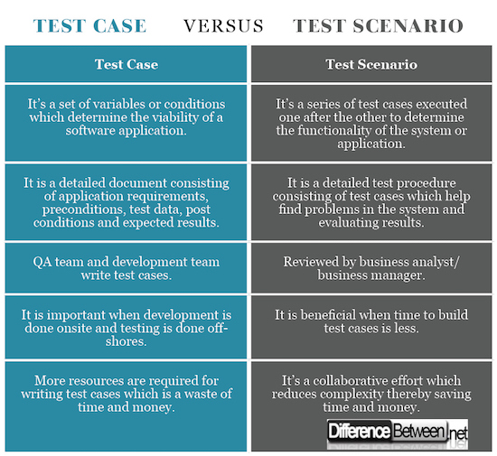

Slide 11
A defect bash:
- A defect bash is an ad hoc testing ,done by people performing different roles in the same time duration during the integration testing phase .
- To bring out all types of defects that may have been left out by planned testing .
The testing by all the participants during defect bash is not based on written test cases.
What is to be tested is left to individual’s decision.
All the activities in the defect bash are planned activities, except for what to be tested.

Slide 12
System testing:
-System testing is a series of different type of tests with the purpose to exercise and examine the full working of an integrated software computer system against requirements.
In other words, a computer system consists of a group of software to perform the various tasks, but only software cannot perform the task; for that software must be interfaced with compatible hardware.
To check the end-to-end flow of an application or the software as a user is known as System testing.

Slide 13
Acceptance testing:
-Acceptance testing is formal testing based on user requirements and function processing.
-It determines whether the software is conforming specified requirements and user requirements or not.
-It is a formal testing according to user needs, requirements and business processes conducted to determine whether a system satisfies the acceptance criteria or not and to enable the users.
-

Slide 14
Acceptance testing:
-Types of Accepting testing:
Business Acceptance Testing (BAT): BAT is used to determine whether the product meets the business goals and purposes or not. BAT mainly focuses on business profits which are quite challenging due to the changing market conditions and new technologies so the current implementation may have to being changed which results in extra budgets.
2) Alpha Testing: Alpha testing is used to determine the product in the development testing environment by a specialized testers team usually called alpha testers.

Slide 15
Acceptance testing:
-Types of Accepting testing:
3) Beta Testing: Beta testing is used to assess the product by exposing it to the real end-users, usually called beta testers in their environment. Feedback is collected from the users and the defects are fixed. Also, this helps in enhancing the product to give a rich user experience

Slide 16
Types of System Testing:
1) Performance Testing: Performance Testing is a type of software testing that is carried out to test the speed, scalability, stability and reliability of the software product or application.
2) Load Testing: Load Testing is a type of software Testing which is carried out to determine the behavior of a system or software product under extreme load.

Slide 17
Types of System Testing:
3) Stress Testing: Stress Testing is a type of software testing performed to check the robustness of the system under the varying loads.
4) Scalability Testing: Scalability Testing is a type of software testing which is carried out to check the performance of a software application or system in terms of its capability to scale up or scale down the number of user request load.

Slide 18
Types of System Testing:
5) Recovery Testing
-Is software testing technique which verifies software’s ability to recover from failures like software/hardware crashes, network failures etc.
The purpose of Recovery Testing is to determine whether software operations can be continued after disaster or integrity loss.
Recovery testing involves reverting back software to the point where integrity was known and reprocessing transactions to the failure point.

Slide 19
Types of System Testing:
6) Security Testing :
-Is a type of Software Testing that uncovers vulnerabilities of the system and determines that the data and resources of the system are protected from possible intruders.
- It ensures that the software system and application are free from any threats or risks that can cause a loss.

Slide 20
